Slide 1
Chapter 2 Bayesian Decision Theory
Classification problem based on the probability
Bayesian Decision Theory
  All the relevant probability values are known
  Minimum--Error/Risk Classification
The Normal Density
  Discriminant Functions for the Normal Density

Slide 2
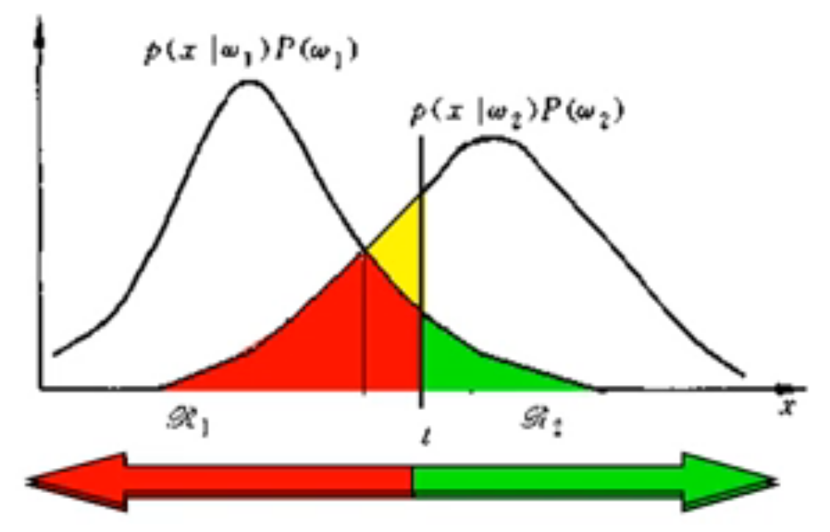
2.1 Classification problem based on minimum error probability
Error probability is the probability defined as follows: a sample belongs to category A but is errorly classified into category B.

Slide 3


2.1 Classification problem based on minimum error probability

Slide 4
Prior information generally comes from historical experience. For example, when the table tennis player Xu Xin competes with Zhang Benzhi , the main person will generally make a judgment on the outcome of this competition based on Xu Xin's achievements in previous competitions.

Slide 5


Slide 6
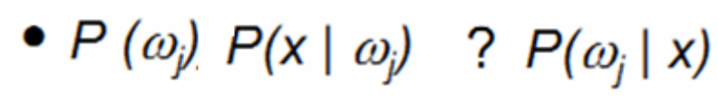

P(x) is teh total probability

Slide 7
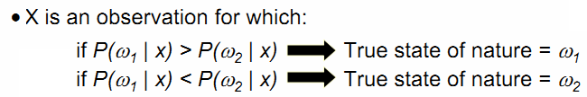
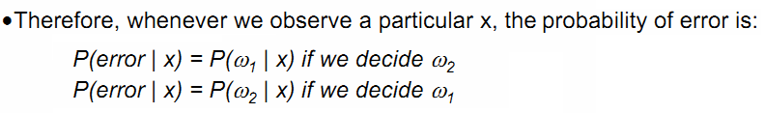

Slide 8
The relationship between the largest posterior probability and the minimum error probability！

Slide 9
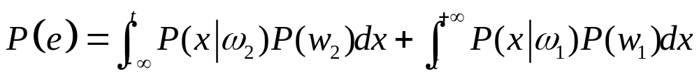
t is the Decision Surface

Slide 10
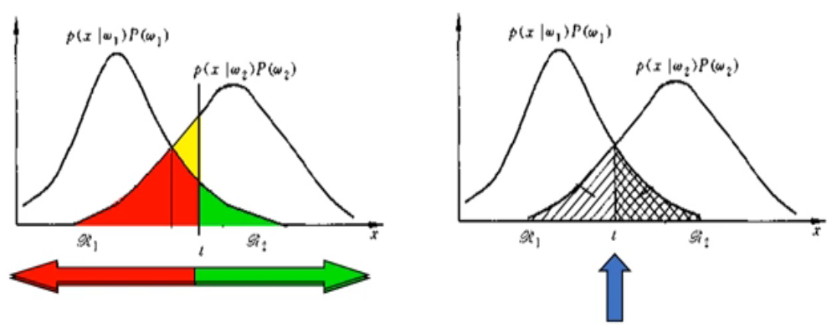
t is the point which makes the posteriors of these two categories equal, then the error is the minimum!

Slide 11
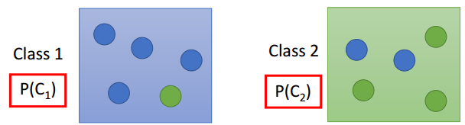


An example of minimum error probability

Slide 12
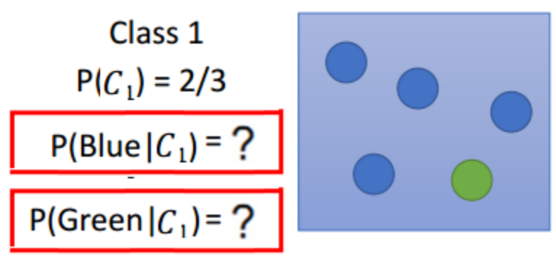
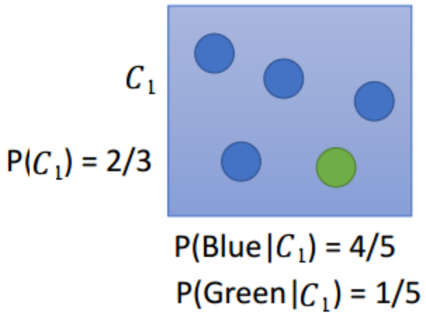
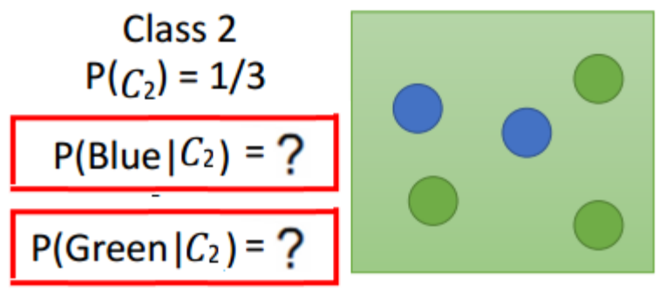
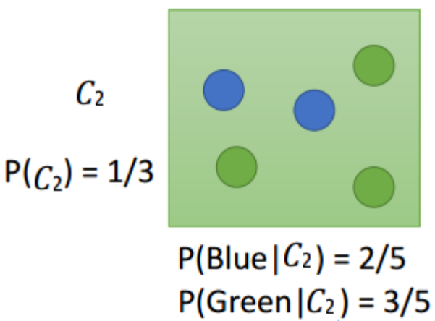
An example of minimum error probability

Slide 13
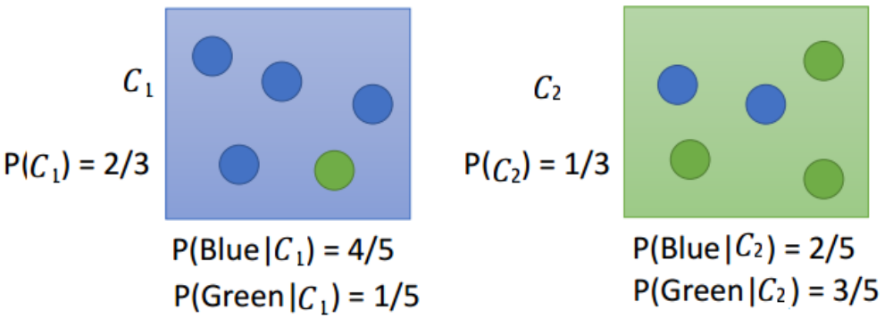
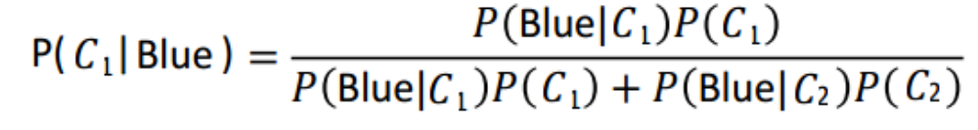
An example of minimum error probability

Slide 14
An example of minimum error probability
Then deciding the sample x belonging to which class using the theory of minimum error probability

Slide 15

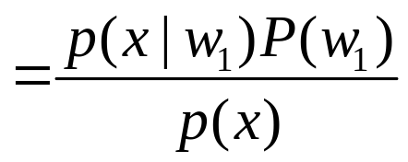
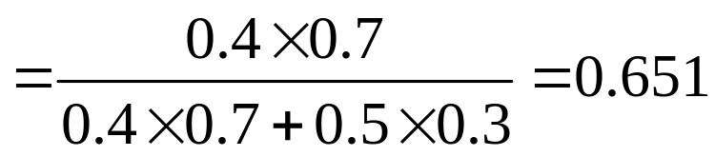
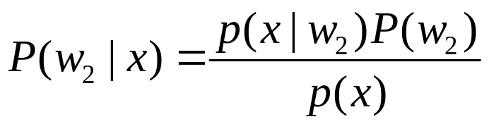
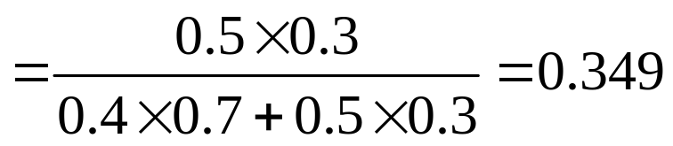
An example of minimum error probability
First：computing the two posterior probabilities based on the rule of Bayesian

Slide 16
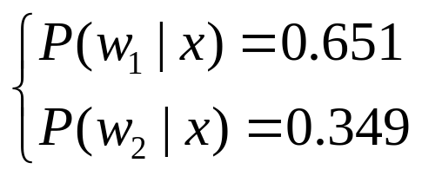

An example of minimum error probability
Second： deciding the sample x belonging to which class using the theory of minimum error probability

Slide 17
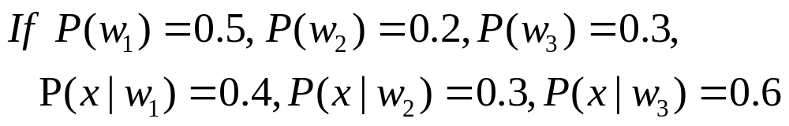
An example of minimum error probability
Then deciding the sample x belonging to which class using the theory of minimum error probability

Slide 18
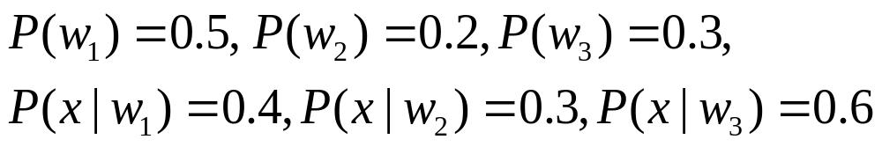
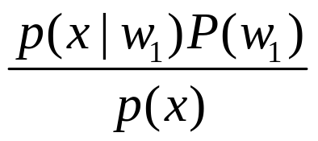
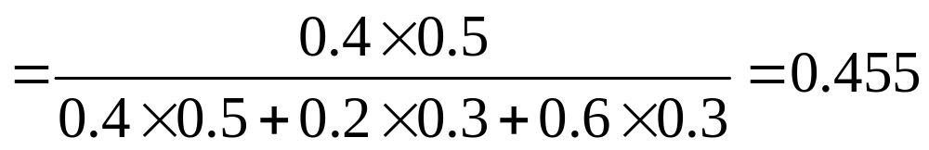
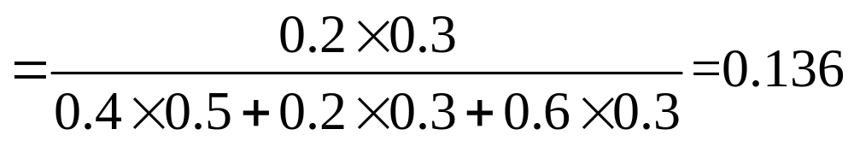

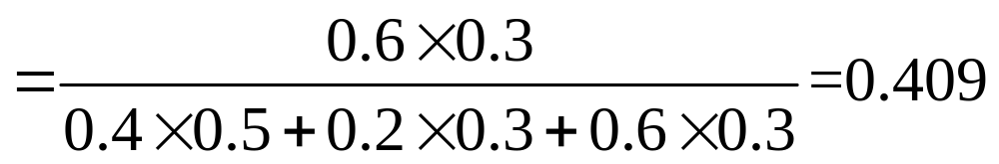
An example of minimum error probability
First：computing the two posterior probabilities based on the rule of Bayesian

Slide 19
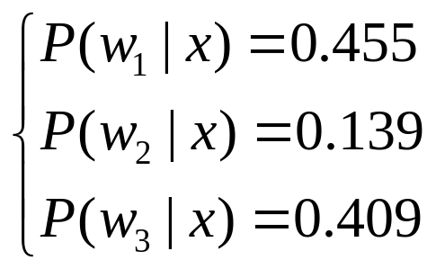
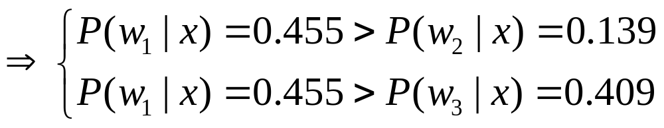

An example of minimum error probability
Second： deciding the sample x belonging to which class using the theory of minimum error probability

Slide 20
2.2 Bayesian Decision Theory—
Minimum risk probability

Slide 22

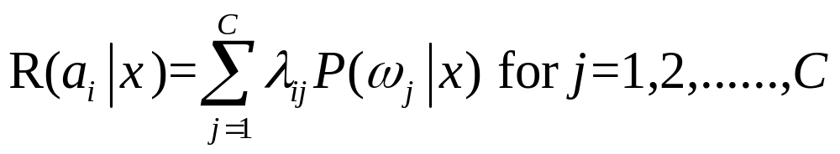

Slide 23

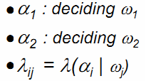

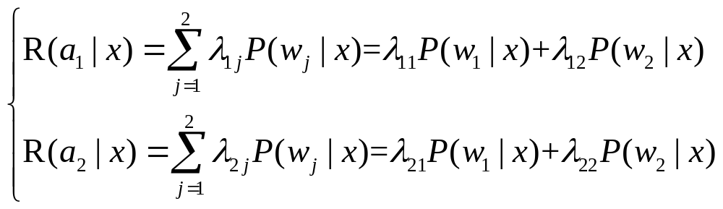

Slide 24






Slide 25
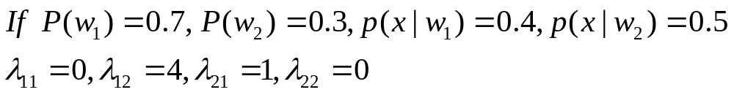
An example of minimum risk probability
Then deciding the sample x belonging to which class using the theory of minimum risk probability

Slide 26

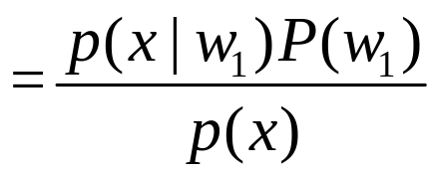
An example of minimum risk probability
First：computing the two posterior probabilities based on the rule of Bayesian

Slide 27
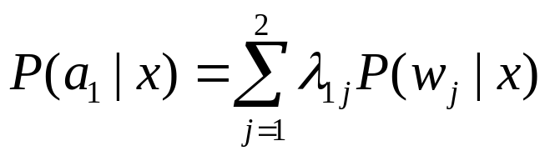


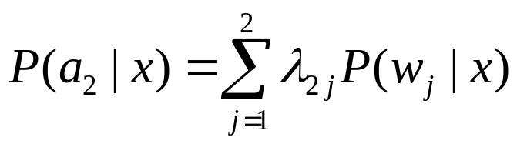


An example of minimum risk probability
Second：computing the two error probabilities

Slide 28
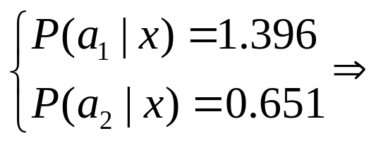
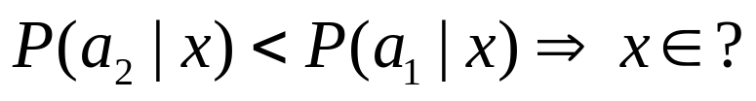

An example of minimum risk probability
Third：deciding the sample x belonging to which class using the theory of minimum error probability

Slide 29
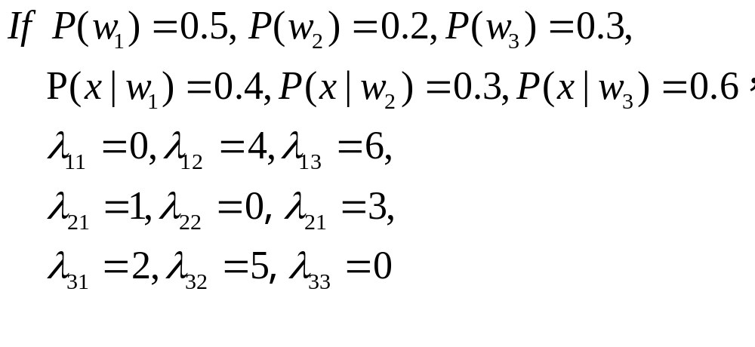
An example of minimum risk probability
Then deciding the sample x belonging to which class using the theory of minimum risk probability

Slide 30
An example of minimum error probability
First：computing the two posterior probabilities based on the rule of Bayesian

Slide 31
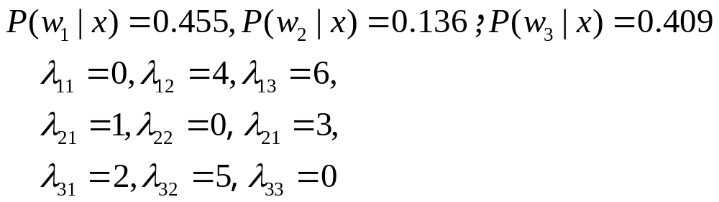

An example of minimum risk probability
Second：computing the two error probabilities

Slide 32

An example of minimum risk probability
Second：computing the two error probabilities

Slide 33

An example of minimum risk probability
Second：computing the two error probabilities

Slide 34
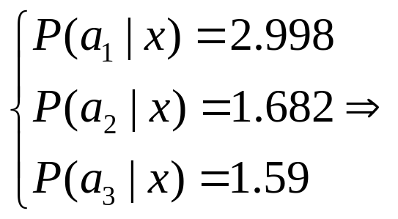
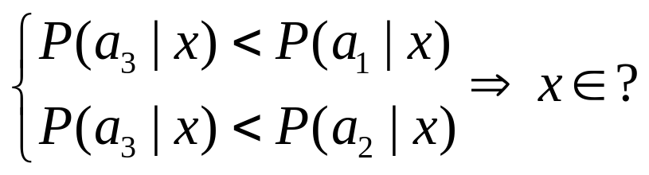

An example of minimum risk probability
Third：deciding the sample x belonging to which class using the theory of minimum error probability

Slide 35


2.3 Classifiers, Discriminant Functions and
Decision Surfaces

Slide 36


2.3 Classifiers, Discriminant Functions and
Decision Surfaces

Slide 37
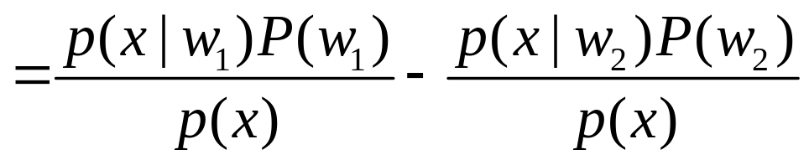
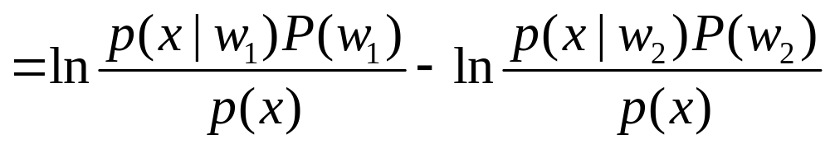
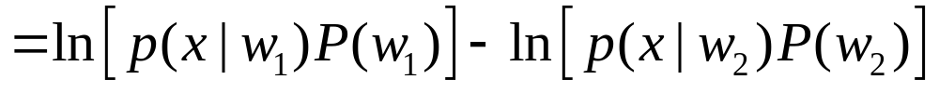
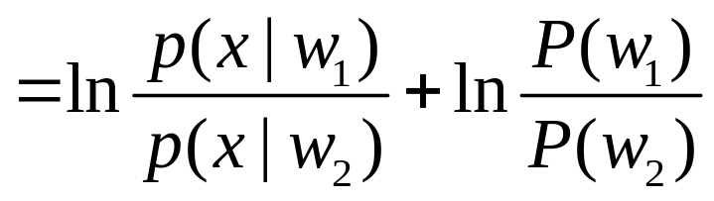

Slide 38


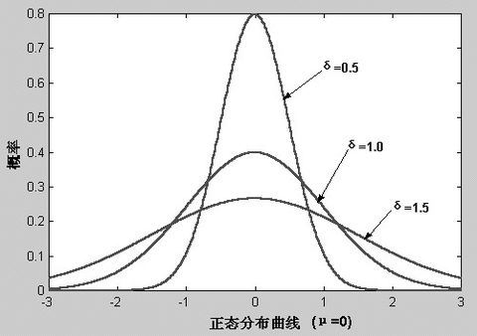
2.4 The Normal Density

Slide 39


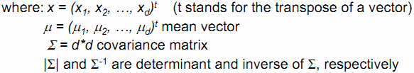

Slide 40
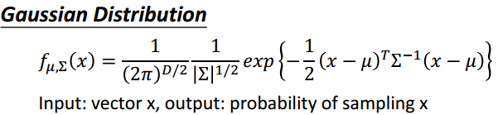
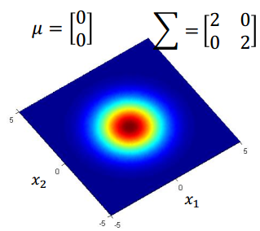
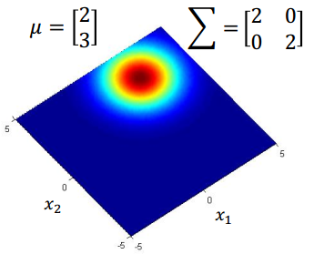

Slide 41
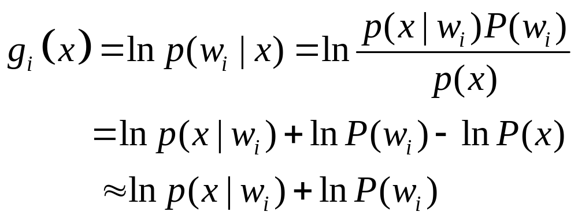
Discriminant Functions for the Normal Density

Slide 42


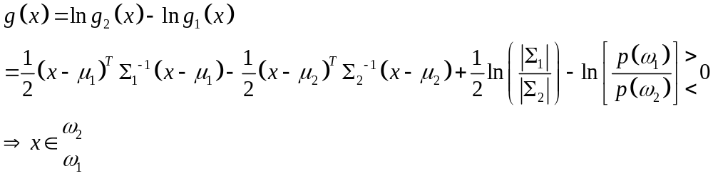
Discriminant Functions for the Normal Density

Slide 43






Slide 44



Slide 45


Given the information as below:
Then deciding the sample x=(0 0)’ belonging to which class using the theory of minimum error probability

Slide 46






First: (1) computing the mean of the first class based on the given information

Slide 47






First: (2) computing the mean of the second class based on the given information

Slide 48



Second: (1) computing the covariance of the first class based on the given information

Slide 49



Second: (1) computing the covariance of the first class based on the given information

Slide 50

Second: (1) computing the covariance of the first class based on the given information

Slide 51


Second: (1) computing the covariance of the first class based on the given information

Slide 52

Second: (1) computing the covariance of the first class based on the given information

Slide 53



Second: (2) computing the covariance of the second class based on the given information

Slide 54



Second: (2) computing the covariance of the second class based on the given information

Slide 55


Second: (2) computing the covariance of the second class based on the given information

Slide 56


Second: (2) computing the covariance of the second class based on the given information

Slide 57

Second: (2) computing the covariance of the second class based on the given information

Slide 58



Second: (3) computing the determinant of two covariance matrixes based on the given information

Slide 59




Second: (3) computing the determinant of two covariance matrixes based on the given information

Slide 60





Second: (4) computing the inverse of two covariance matrixes based on the given information

Slide 61




Second: (4) computing the inverse of two covariance matrixes based on the given information

Slide 62
Third：deciding the sample x belonging to which class using the theory of minimum error probability

Slide 63




Third：deciding the sample x belonging to which class using the theory of minimum error probability

Slide 64

Third：deciding the sample x belonging to which class using the theory of minimum error probability

Slide 65
Given the information as below:
Sample No. | 1 2 3 | 1 2 3
Feature 1 | 1 1 2 | -1 -1 -2
Feature 2 | 1 0 -1 | 1 0 -1
Class | 1 | 2
Then deciding the sample x=(0 0)’ belonging to which class using the theory of minimum error probability

Slide 66
Given the information as below:
Sample No. | 1 2 3 | 1 2 3
Feature 1 | 1 1 2 | -1 -1 -2
Feature 2 | 1 0 -1 | 1 0 -1
Class | 1 | 2
Then deciding the sample x=(0 0)’ belonging to which class using the theory of minimum error probability

Slide 68



Minimum error probability based classification

Slide 69


Slide 70



Slide 72
Sample No. | 1 2 3 4 5 | 1 2 3 4
Feature x₁ | 1 1 0 -1 -1 | 0 1 0 -1
Feature x₂ | 0 1 1 1 0 | -1 -2 -2 -2
Sample Class | ω₁ | ω₂
Then deciding the sample x=(0 0)’ belonging to which class using the theory of minimum error probability

